Slide 1
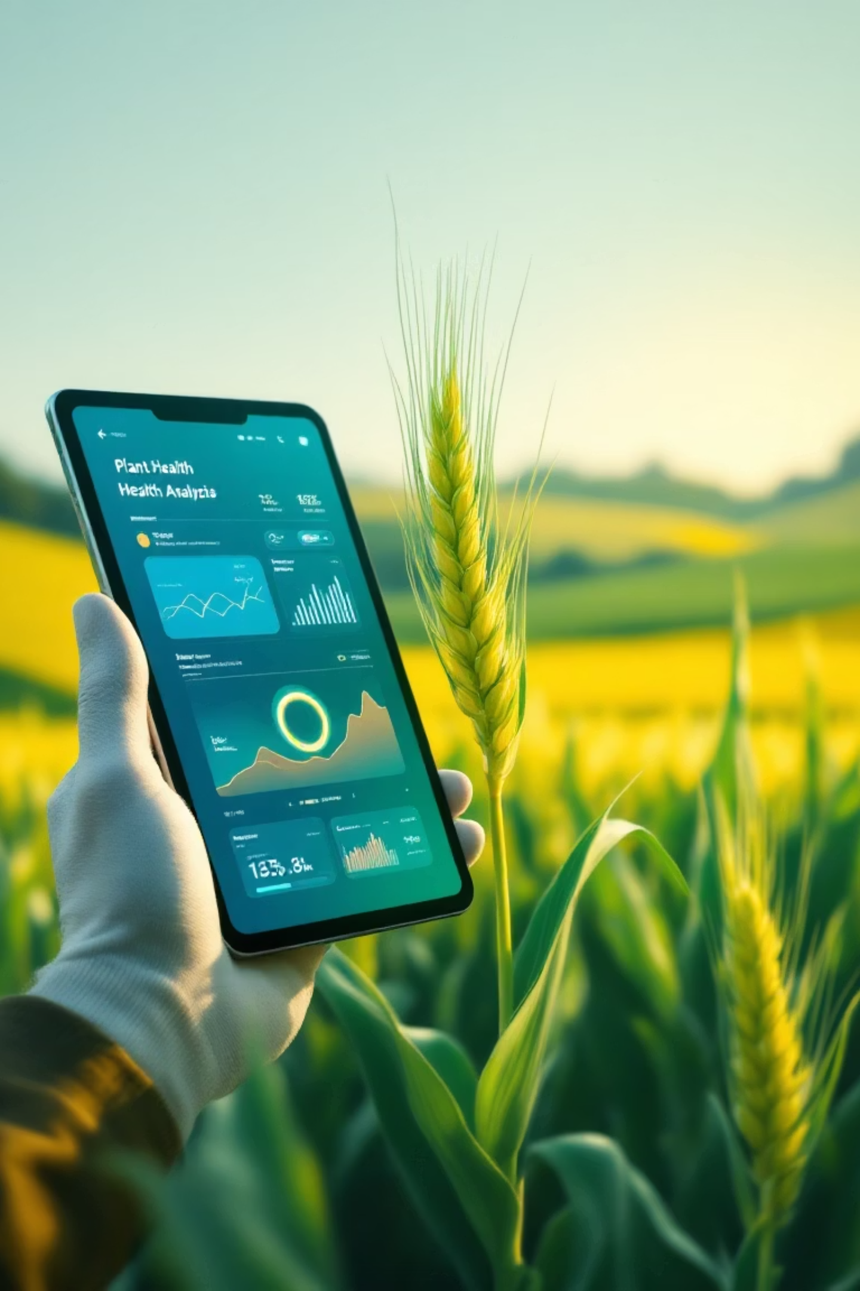
Agrobot
An AI-Powered Agricultural Assistant for Disease Diagnosis
Presented by: Hitesh Shraan

Slide 2

The Challenge Farmers Face Daily
Delayed Diagnosis
Limited Expert Access
Farmers struggle to quickly identify plant diseases, leading to significant crop loss and reduced yields.
Agricultural expertise isn't always available, especially in remote farming communities.
Language Barriers
Most technical solutions are only available in English, excluding many local farmers.

Slide 3
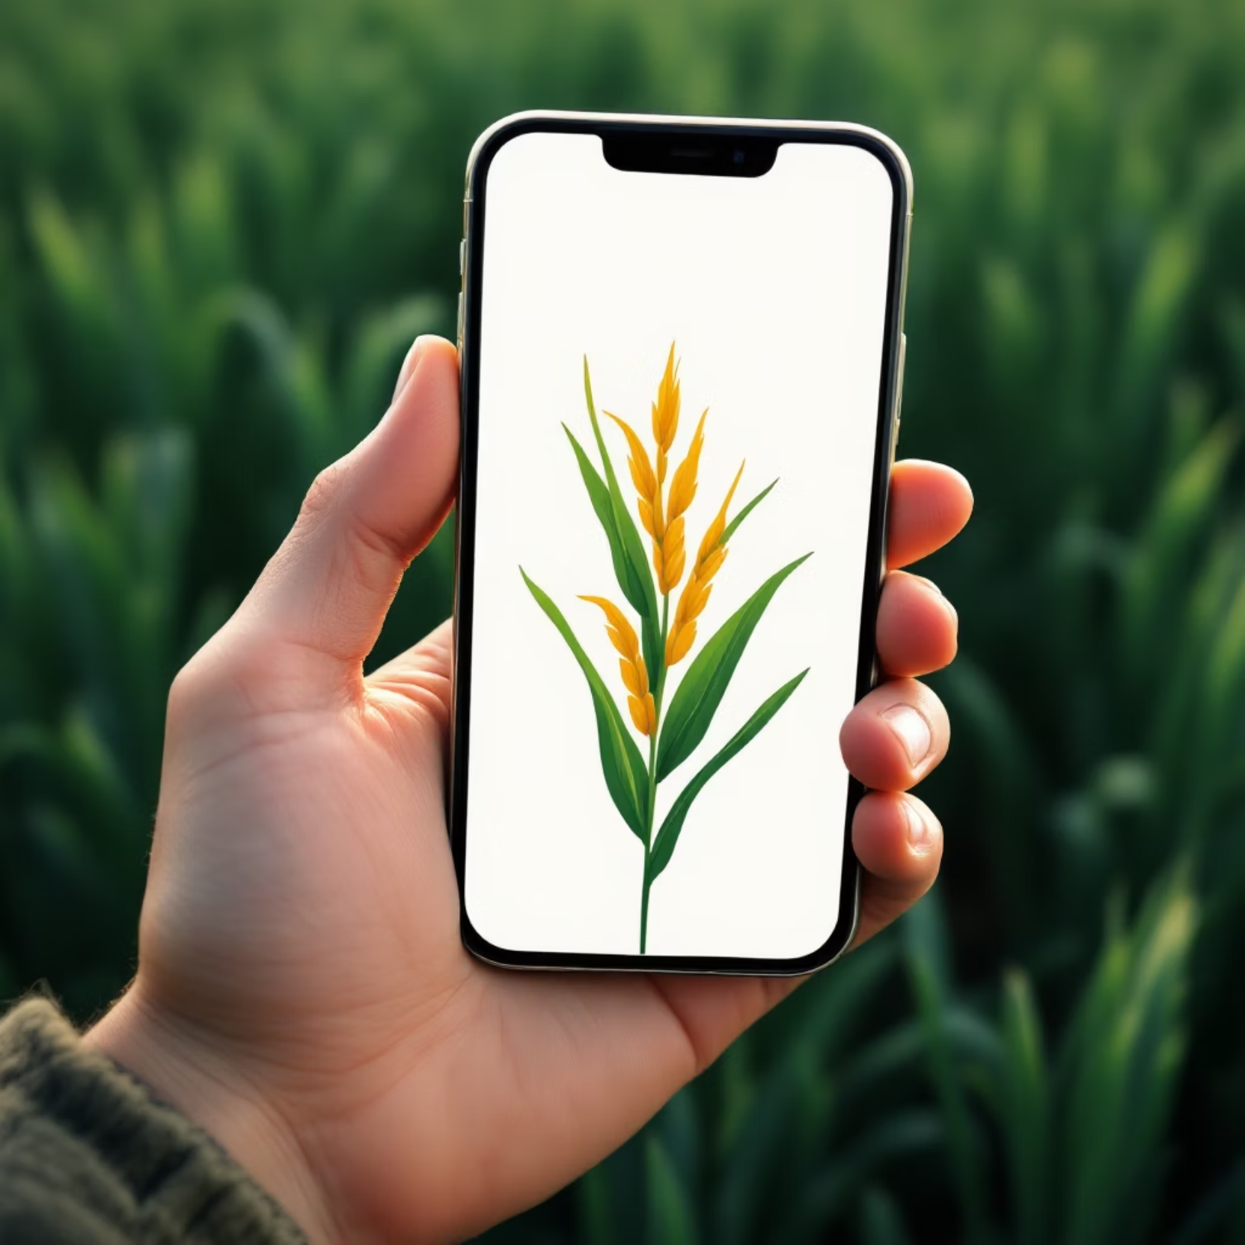
Introducing Agrobot
Instant, Multilingual Diagnosis
AgroScribe empowers farmers with intelligent plant disease identification that works in their native language.
Instant plant disease identification
Actionable treatment solutions
Available in English, Hindi, and Punjabi

Slide 4




Powerful Features for Modern Farming
Image-Based Diagnosis
Text-Based Chatbot
Upload photos for instant AI-powered disease recognition using advanced machine learning models.
Describe symptoms in plain language and receive expert guidance through intelligent conversation.
Full Multilingual Support
Admin Management Panel
Complete interface translation ensures seamless experience in English, Hindi, and Punjabi.
Secure backend system for viewing, adding, editing, and managing disease database entries.

Slide 5

Built on Cutting-Edge Technology
Frontend & Interface
AI & Machine Learning
Streamlit Framework provides intuitive, responsive user experience
TensorFlow (Keras) for image classification and NLTK for natural language processing
Data & Translation
JSON storage for user data and Google Translate API for automated multilingual support

Slide 6




How Agrobot Works
Secure Access
Language Selection
Farmers and admins login through role-based authentication system
Choose preferred language for complete interface experience
Diagnosis Method
Instant Results
Select image upload or text-based symptom description
Receive diagnosis and actionable treatment recommendations

Slide 7

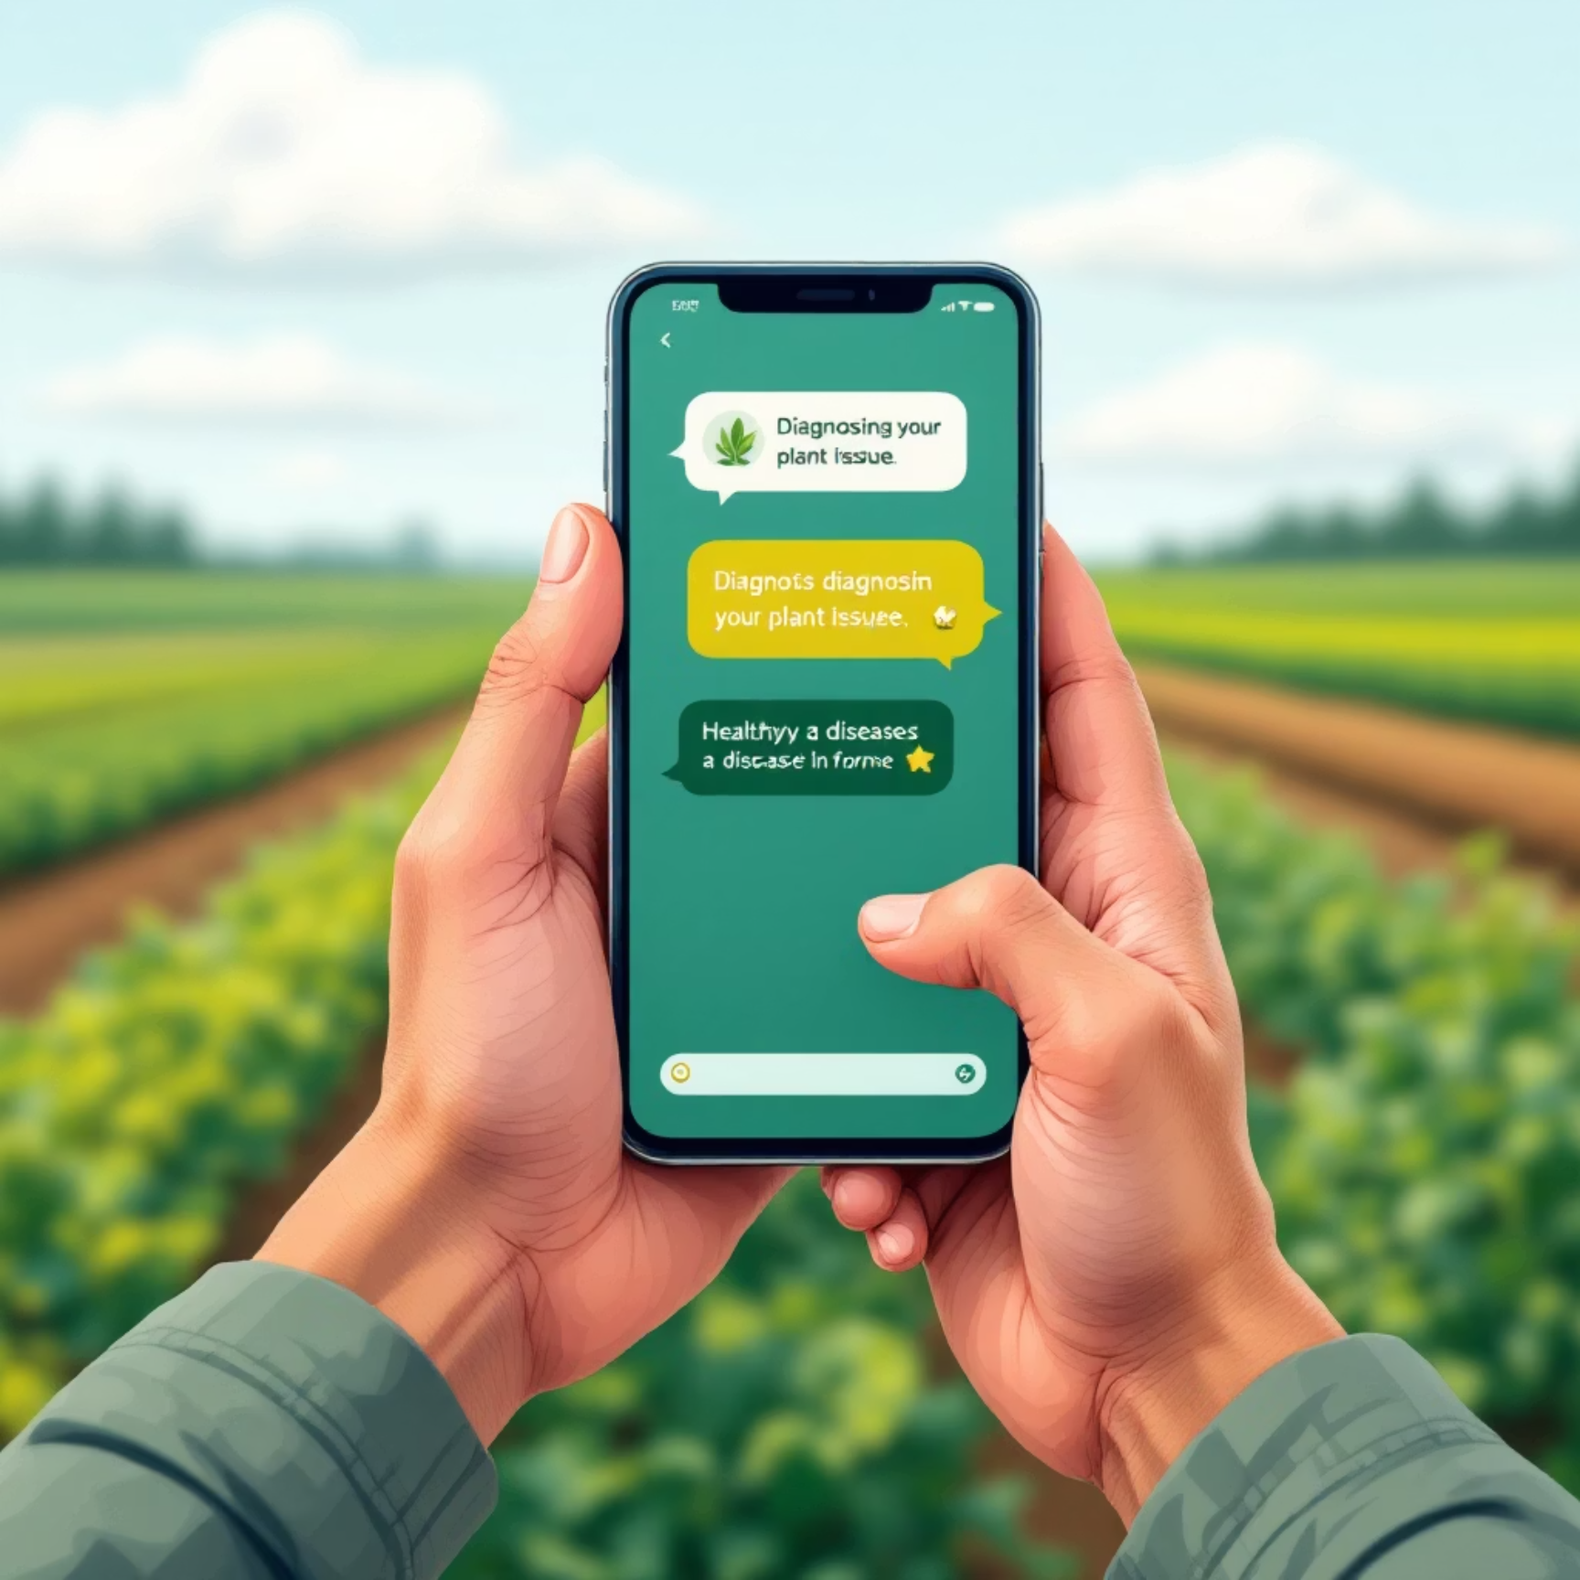
Experience the Farmer Interface
📸 Diagnose by Image
💬 Diagnose by Text
Simply upload a photo of the affected plant and receive instant AI-powered diagnosis with treatment solutions in your chosen language.
Describe symptoms to our intelligent chatbot, which provides detailed diagnosis with engaging word-by-word response animation.

Slide 8

Comprehensive Admin Control
Complete Database Management
Full CRUD operations for disease entries with intuitive content management interface
Automated Translation System
Add diseases in one language and automatically generate translations for multilingual support
Comprehensive Analytics
Track farmer queries and identify common disease patterns to improve service delivery

Slide 9
Future Enhancements
Cloud Database Migration
Advanced Features
Scale from JSON to PostgreSQL or Firebase for enhanced performance and reliability
Integrate weather data for disease prediction and add comprehensive pest identification
1
2
3
4
Enhanced AI Capabilities
Mobile Application
Continuously improve model accuracy with user-submitted images and expand disease recognition
Develop native mobile app for seamless field-based disease diagnosis and treatment

Slide 10

Empowering Agriculture Through Technology
AgroScribe demonstrates how AI can solve critical agricultural challenges by combining advanced technology with accessibility and ease of use.
By focusing on multilingual support and intuitive design, we're helping farmers reduce crop loss, improve yields, and build more sustainable agricultural practices for the future.

